Slide 1
Regular Expressions and Finite State Automata

Slide 2
Regular Expressions
A regular expression, regex or regexp is, in theoretical computer science and formal language theory, a sequence of characters that define a search pattern
Usually this pattern is then used by string searching algorithms for "find" or "find and replace" operations on strings

Slide 3
Regular Expressions
A regular expression is a text string that defines a character pattern
One use of regular expressions is pattern-matching, in which a text string is tested to see whether it matches the pattern defined by a regular expression
https://en.wikipedia.org/wiki/Regular_expression

Slide 4
Regular Expressions
Mathematician Stephen Cole Kleene formalized the description of a regular language in the 1950s
A regular language can be defined as a language recognized by a finite automaton (Kleene's theorem)
A finite-state machine (FSM) or finite-state automaton (FSA, plural: automata), finite automaton, or simply a state machine, is a mathematical model of computation
It is an abstract machine that can be in exactly one of a finite number of states at any given time
https://en.wikipedia.org/wiki/Regular_expression
Notes:
An automaton (pronunciation: /ɔːˈtɒmətən/)(plural: automata or automatons) is a self-operating machine, or a machine or control mechanism designed to automatically follow a predetermined sequence of operations, or respond to predetermined instructions.

Slide 5
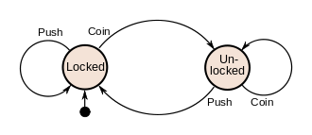
Finite-state machine
Current state Input | State A | State B | State C
Input X | … | … | …
Input Y | … | State C | …
Input Z | … | … | …

Slide 6
Regular Expressions
Every transition of a DFA consumes a symbol
Regular expressions are used throughout UNIX:
Editors: ed, ex, vi
Utilities: grep, egrep, sed, and awk

Slide 7
UNIX
Pattern search is a useful activity and can be used in many applications
Use wildcards such as *
Example:
ls *.c
Lists all the files with c extension or
ls ab*
lists all file names that starts with ab in the current directory

Slide 8
UNIX
Metacharacters
Twelve characters that have special meanings in regular expressions
\ the backslash
^ the caret
$ the dollar sign
. the period or dot
| the vertical bar or pipe symbol
? the question mark
* the asterisk or star
+ the plus sign
( the opening parenthesis
) the closing parenthesis
[ the opening square bracket
{ the opening curly brace.

Slide 9
Regular Expressions
RE Metacharacter | Matches…
. | Any one character, except new line
[a-z] | Any one of the enclosed characters (e.g. a-z)
* | Zero or more of preceding character
? or \? | Zero or one of the preceding characters
+ or \+ | One or more of the preceding characters

Slide 10
Regular Expressions
\m | Matches literal character m
^ | Start of line
$ | End of line
. | Any single character
[xy^$x] | Any of x, y, ^, $, or z
[^xy^$z] | Any one character other than x, y, ^, $, or z
[a-z] | Any single character in given range
r* | zero or more occurrences of regex r
r1r2 | Matches r1 followed by r2

Slide 11
Regular Expressions
\(r\) | Tagged regular expression, matches r
\n | Set to what matched the nth tagged expression (n = 1-9)
\{n,m\} | Repetition

Slide 12
Regular Expressions
\b | Matches a word boundary, that is, the position between a word and a space. For example, er\b matches the er in "never" but not the er in verb.
\B | Matches a word boundary, that is, the position between a word and a space. For example, er\b matches the er in "never" but not the er in verb.
\d | Matches a nonword boundary. ea*r\B matches the ear in never early

Slide 13
Regular Expressions
\D | Matches a nondigit character. Equivalent to [^0-9].
\f | Matches a form-feed character.
\n | Matches a newline character.
\r | Matches a carriage return character.
\s | Matches any white space including space, tab, form-feed, etc. Equivalent to [ \f\n\r\t\v].
\S | Matches any nonwhite space character. Equivalent to [^ \f\n\r\t\v].

Slide 14
Regular Expressions
\t | Matches a tab character.
\v | Matches a vertical tab character.
\w | Matches any word character including underscore. Equivalent to [A-Za-z0-9_].
\W | Matches any nonword character. Equivalent to [^A-Za-z0-9_].

Slide 15
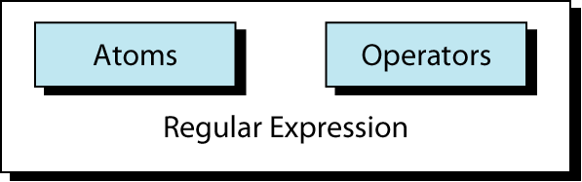
Regular Expressions
An atom specifies what text is to be matched and where it is to be found.
An operator combines regular expression atoms

Slide 16
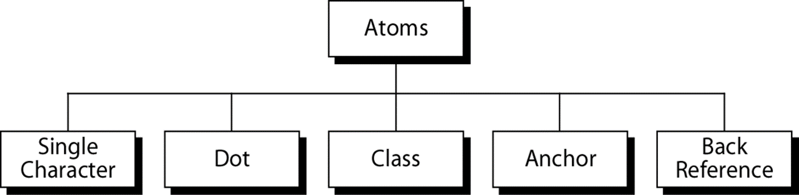
Regular Expressions
Atoms
An atom specifies what text is to be matched and where it is to be found.

Slide 17
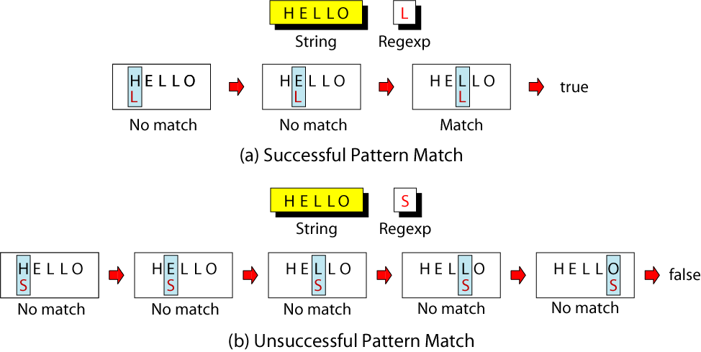
Regular Expressions
Single-Character Atom
A single character matches itself

Slide 18
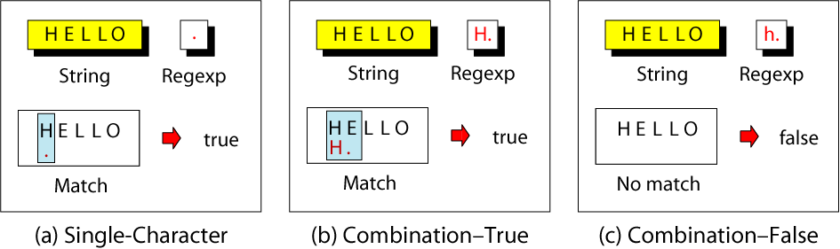
Regular Expressions
Dot Atom
matches any single character except for a new line character (\n)

Slide 19
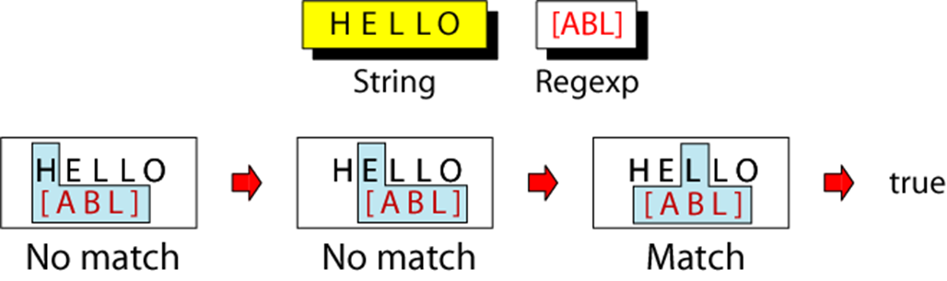
Regular Expressions
Class Atom
matches only single character that can be any of the characters defined in a set:
Example: [ABC] matches either A, B, or C.
Notes:
1) A range of characters is indicated by a dash, e.g. [A-Q]
2) Can specify characters to be excluded from the set, e.g.
[^0-9] matches any character other than a number.

Slide 20
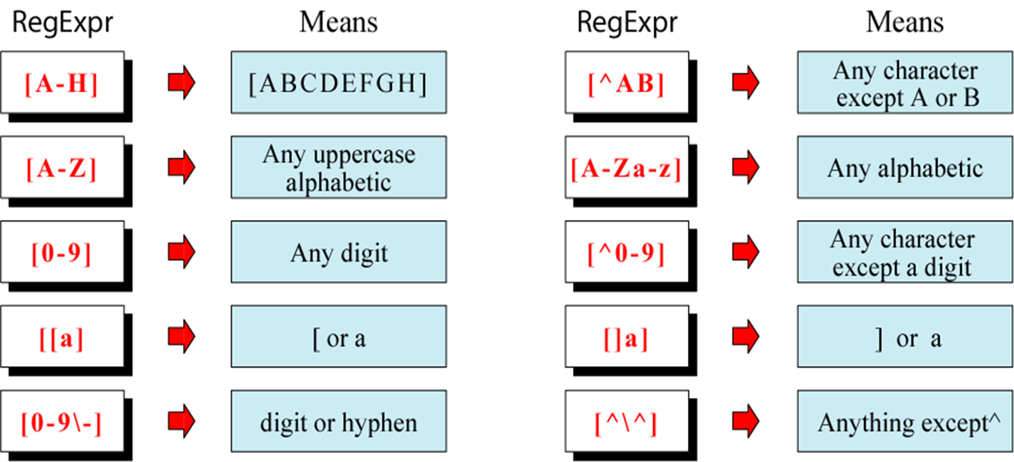
Regular Expressions
Class Atom Examples

Slide 21
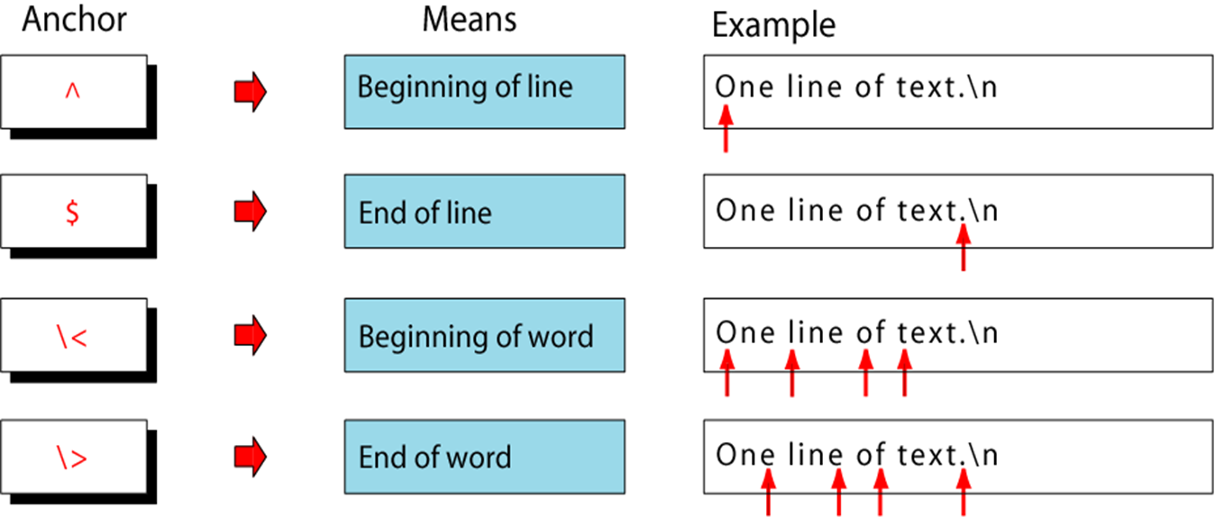
Regular Expressions
Anchors
Anchors tell where the next character in the pattern must be located in the text data

Slide 22
Regular Expressions
Back References: \n
used to retrieve saved text in one of nine buffers
can refer to the text in a saved buffer by using a back reference:
Example: \1 \2 \3 ...\9

Slide 23
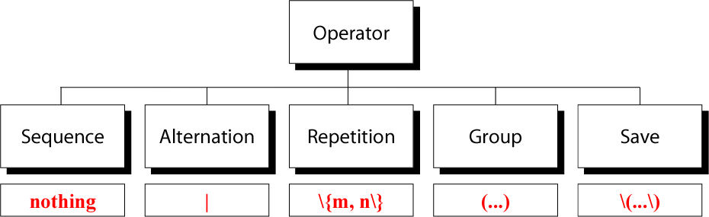
Regular Expressions
Operators

Slide 24
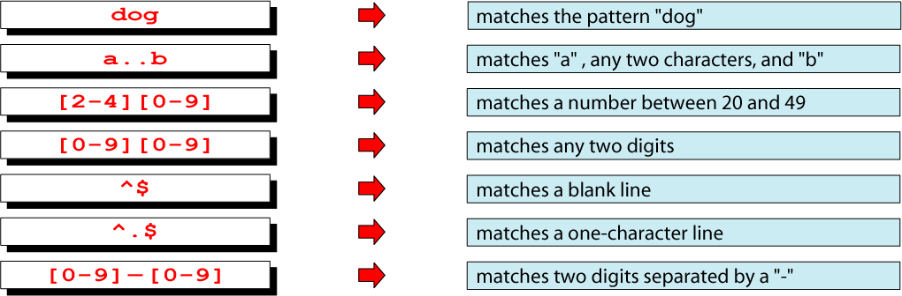
Regular Expressions
Sequence Operators
In a sequence operator, if a series of atoms are shown in a regular expression, there is no operator between them

Slide 25
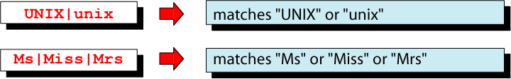
Regular Expressions
Alternation Operator: | or \|
operator (| or \| ) is used to define one or more alternatives

Slide 26
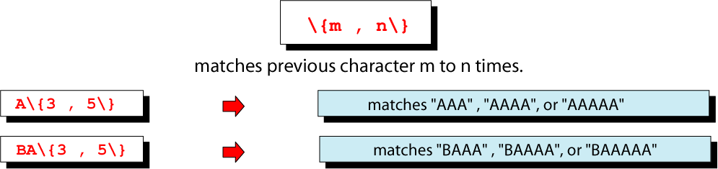
Regular Expressions
Repetition Operator: \{…\}
The repetition operator specifies that the atom or expression immediately before the repetition may be repeated

Slide 27
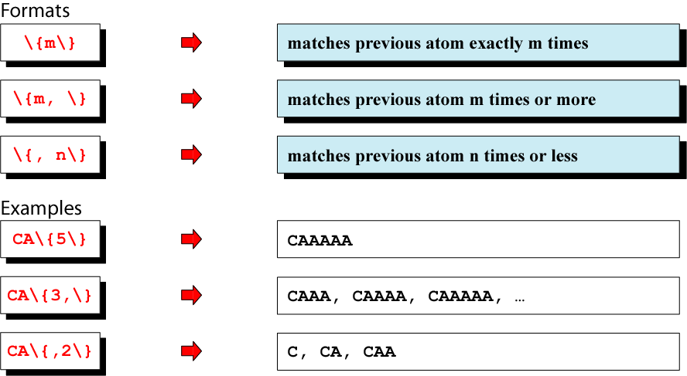
Regular Expressions
Short Form Repetition Operators

Slide 28
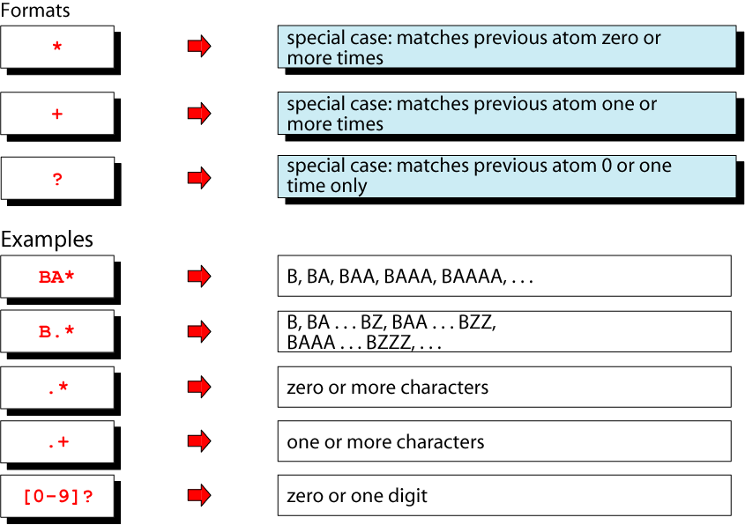
Regular Expressions
Basic Repetition Forms

Slide 29
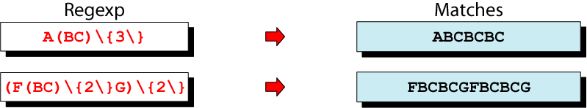
Regular Expressions
Group Operator
In the group operator, when a group of characters is enclosed in parentheses, the next operator applies to the whole group, not only the previous characters
depends on version of “grep”
use \( and \) instead
Notes:
depends on version of “grep”
use \( and \) instead

Slide 30
Regular Expressions
The . regular expression can be used to match any character
regular expression
o .
For me to …… on.
match 1
match 2

Slide 31
Regular Expressions
Character classes can be negated with the [^] syntax
regular expression
b [^eo] a t
beat a brat on a boat
match
no match

Slide 32
UNIX
Other examples of character classes:
[aeiou] will match any of the characters a, e, i, o, or u
[kK]orn will match korn or Korn
Ranges can also be specified in character classes
[1-9] is the same as [123456789]
[abcde] is equivalent to [a-e]

Slide 33
UNIX
You can also combine multiple ranges
[abcde123456789] is equivalent to [a-e1-9]
Note that the ─ character has a special meaning in a character class but only if it is used within a range
[-123] would match the characters ─, 1, 2, or 3

Slide 34

Regular Expressions
the set of strings matched by the regular expression a(bb)+a
https://swtch.com/~rsc/regexp/regexp1.html

Slide 35
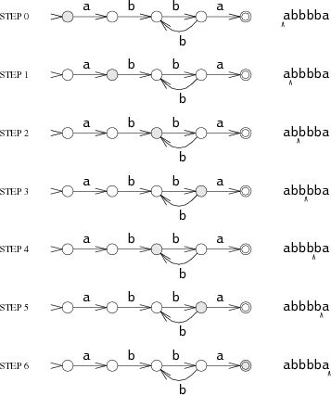
the set of strings matched by the regular expression abbbba
Notes:
The machine reads an input string one character at a time, following arrows corresponding to the input to move from state to state. Suppose the input string is abbbba. When the machine reads the first letter of the string, the a, it is in the start state s₀. It follows the a arrow to state s₁. This process repeats as the machine reads the rest of the string: b to s₂, b to s₃, b to s₂, b to s₃, and finally a to s₄.
The machine ends in s₄, a matching state, so it matches the string. If the machine ends in a non-matching state, it does not match the string. If, at any point during the machine's execution, there is no arrow for it to follow corresponding to the current input character, the machine stops executing early.

Slide 36

Regular Expressions
the set of strings matched by the regular expression a(bb)+a
Notes:
The machine we have been considering is called a deterministic finite automaton (DFA), because in any state, each possible input letter leads to at most one new state. We can also create machines that must choose between multiple possible next states. For example, this machine is equivalent to the previous one but is not deterministic:The machine is not deterministic because if it reads a b in state s₂, it has multiple choices for the next state: it can go back to s₁ in hopes of seeing another bb, or it can go on to s₃ in hopes of seeing the final a. Since the machine cannot peek ahead to see the rest of the string, it has no way to know which is the correct decision.

Slide 37

Regular Expressions
the set of strings matched by the regular expression a(bb)+a
Notes:
Sometimes it is convenient to let NFAs have arrows with no corresponding input character. We will leave these arrows unlabeled. An NFA can, at any time, choose to follow an unlabeled arrow without reading any input. This NFA is equivalent to the previous two, but the unlabeled arrow makes the correspondence with a(bb)+a clearest:

Slide 38
Regular Expressions
transition labels are regular expressions

